Slide 1
E-Commerce Customer Segmentation
A Machine Learning Approach for Customer Behavior Analysis

Slide 2
Problem Statement
E-commerce companies serve millions of customers with different purchasing behaviors. Without customer segmentation, businesses struggle to provide personalized experiences and targeted marketing. The objective of this project is to classify customers into meaningful groups using data analysis and machine learning techniques.
Machine learning is an up-and-coming tool that has become invaluable for Customer Segmentation. As it allows businesses to identify hidden patterns without any help from predefined labels, it has become increasingly popular. One of the most sought-after ML methods is K-Means ClusterIng.
K-Means Clustering has been used in this project to analyze consumer data and study demographic and spending-related attributes such as age, annual income, and spending score. I have also made use of other methods like data processing, EDA, feature scaling, clustering, and visualization of customer segments. Finally, an interactive dashboard has been developed using Streamlit that allows users to explore the dataset and clustering results in a user-friendly manner.
Customer Data
Different Behaviours
Need Segmentation
K-Means Clustering
Business Decisions

Slide 3
Objectives
Analyze customer purchasing behaviour
Preprocess and clean the dataset
Perform Exploratory Data Analysis (EDA)
Apply K-Means clustering
Develop an interactive Streamlit dashboard
Generate business insights for decision-making

Slide 4
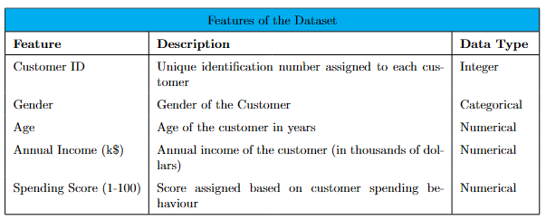
Dataset Description
Source of the Data: For this project, I have used a dataset available on Kaggle titled store_customers.csv. This is a dataset commonly used for Customer Segmentation and clustering which makes it a good fit for the project. It includes all important demographic and spending-related information of the customers at the mall.

Slide 5
Dataset Management
Data Collection
I had to import the data from the dataset into my Python notebook to start
working on it. To do so, I used the pandas library. The dataset was stored in CSV (Comma-Separated Values) format.
Data
Inspection
Before preprocessing, the dataset was inspected to identify missing values, duplicate records, and inconsistencies in the data by using functions such as head(), info(), describe(), columns, and dtype.
Missing
Values
During inspection, missing values were identified in several columns. The K-Means method requires us to remove these records before training the model.
Duplicates
Similarly, duplicate observations were removed using the Pandas drop_duplicates() function.
Selecting
Features
I chose the Annual Income and Spending Score features because they best represent customer purchasing behaviour .

Slide 6
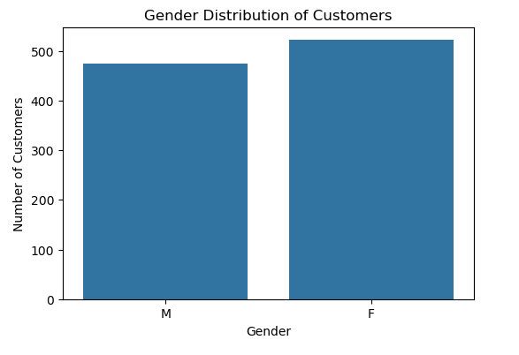
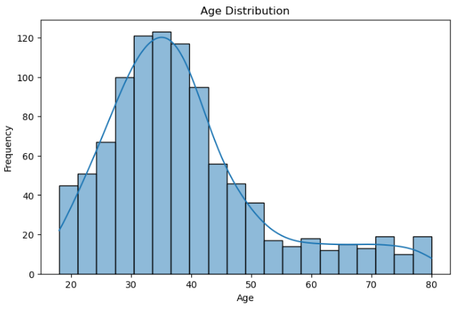
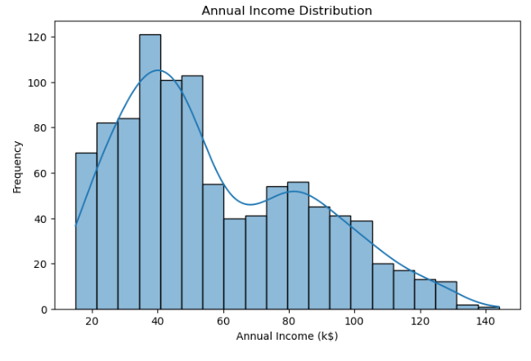
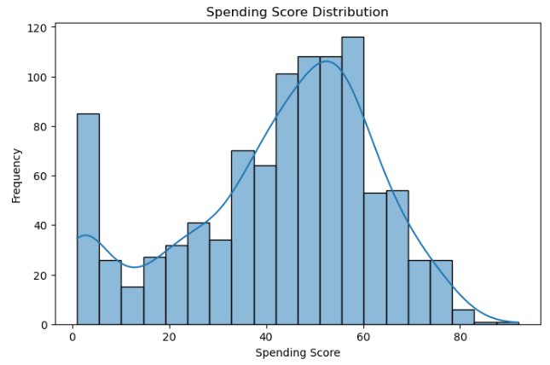
Exploratory Data Analysis
Looking at the Gender Distribution Chart helps us understand the number of male and female. As can be seen, there is but little difference in their numbers, with female customers leading by a few digits.
I have used a histplot to show that customers belong to a wide range of age groups. Most customers are concentrated within the young adult and middle-aged categories, while comparatively fewer customers belong to the higher age groups
The annual income distribution demonstrates variation in customer income levels across the dataset. Most customers fall within the middle-income range, while fewer customers are observed at the extreme lower and higher income levels. This helps us identify that most of our consumer base is part of the middle class.
The spending score represents the purchasing behavior of customers on a scale from 1 to 100. The distribution indicates that customers exhibit varying spending habits, ranging from low to high spending levels. This variation provides meaningful information for identifying distinct customer segments during clustering. There are two peaks in the plot - people are either spending very little, or they are spending a lot.

Slide 7
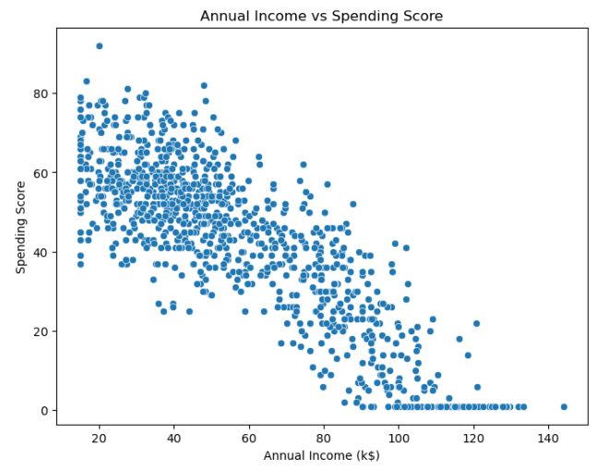
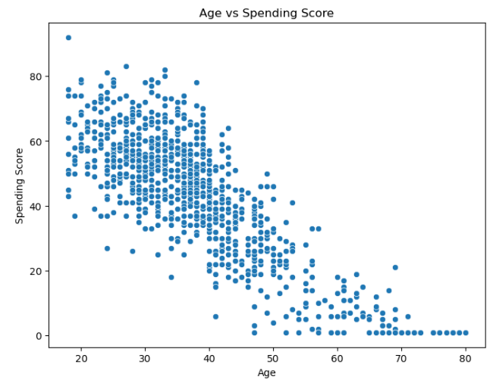
Exploratory Data Analysis
The analysis indicates that no strong linear correlation exists between annual income, spending score, and age. This suggests that each variable contributes unique information to the customer segmentation process. This supports the use of clustering techniques to identify patterns that are not immediately apparent through pairwise correlations.
Using the spending score chart, I noticed that people are either spending a lot of money or they aren’t. I wanted to investigate this relationship further by comparing the spending score with age, gender and income to see if anything comes up.
In the case of Annual Income as well, there is a negative trend. In general, as annual income increases, spending scores tend to decrease. However, the plot is important for one more reason. Several dense regions of points are visible, suggesting natural customer groupings, which provide strong justification for applying the K-Means clustering algorithm to identify meaningful customer segments.
Since I observed a noticeable negative relationship in the first and third plots, I calculated the
Pearson correlation coefficients for the two cases. Now, for the case of Age and Spending Score, the value -0.835 is very close to -1, which indicates a strong negative linear relationship. This confirms our understanding that as Age increases, Spending Score tends to decrease.
The Coefficient for Annual Income is -0.846073, which is even stronger than the other. This means that as Annual Income increases, Spending Score generally decreases.

Slide 8
Customer Segmentation using
K-Means Clustering
Using the Standard Scalar method on the selected features
K-Means is an unsupervised machine learning algorithm widely used for clustering tasks. Unlike supervised learning algorithms, K-Means does not require labeled data. Instead, it partitions observations into a predefined number of clusters based on the similarity of their features. The algorithm
aims to minimize the distance between data points and the centroid of the cluster to which they belong. In this project, K-Means clustering was employed to identify groups of customers with similar purchasing behaviour based on their annual income and spending score.
Selecting appropriate features is a critical step in the clustering process. For this project, Annual Income and Spending Score were chosen as the clustering variables because they directly represent customers’ purchasing capacity and spending behaviour.
Since K-Means is a distance-based algorithm, feature scaling was performed before clustering. Standardization was applied using the StandardScaler technique, which transforms each feature to have a mean of zero and a standard deviation of one. This prevents variables with larger numerical values from dominating the clustering process and ensures that both features contribute equally to the calculation of distances.
Elbow Method
k=4
K-Means Algorithm
Cluster Analysis

Slide 9
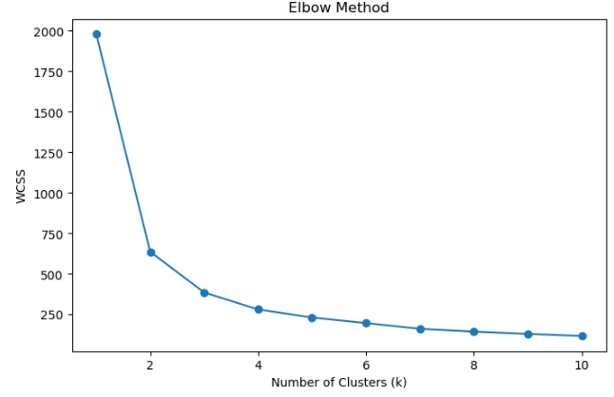
Determining the Optimal Number of Clusters (Elbow Method)
Selecting an appropriate number of clusters is essential for effective segmentation. The Elbow Method was used to determine the optimal value of k by plotting the Within-Cluster Sum of Squares (WCSS) against different numbers of clusters. The graph showed a noticeable bend at
k = 4
indicating that increasing the number of clusters beyond this point resulted in only marginal improvements. Therefore, four clusters were selected for the K-Means model.
After selecting the optimal number of clusters, the K-Means algorithm was trained using the standardized annual income and spending score features. Each customer was assigned to one of four
clusters based on similarity to the corresponding cluster centroid. The trained model produced customer groups that were later visualized and analyzed to identify distinct purchasing patterns.

Slide 10
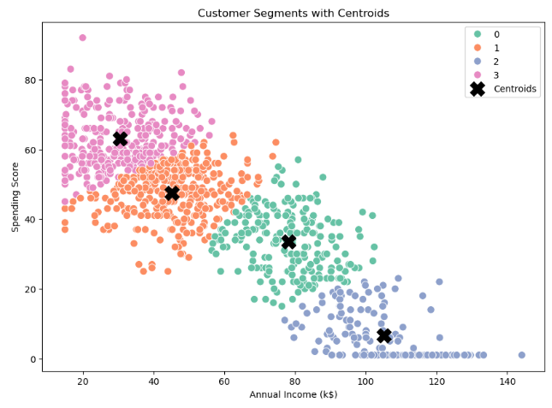
Cluster Visualization
Each colour represents a unique customer segment, while the black markers indicate the cluster centroids. The visualization demonstrates that the algorithm successfully separated customers into distinct groups based on annual income and spending behaviour. The centroids represent the average characteristics of each cluster and serve as the reference point for assigning customers to their respective segments.
Cluster 0: Consists of middle-aged customers with relatively high incomes but below-average spending scores. Despite having good purchasing power, they spend conservatively.
Cluster 1: Consists of older, high-income customers who spend very little. They have the highest average income but the lowest spending score, indicating untapped purchasing potential.
Cluster 2: These customers are the youngest group with the lowest average income but the highest spending score. They appear to be highly engaged shoppers despite having relatively limited purchasing power.
Cluster 3: These customers are the youngest group with the lowest average income but the highest spending score.

Slide 11
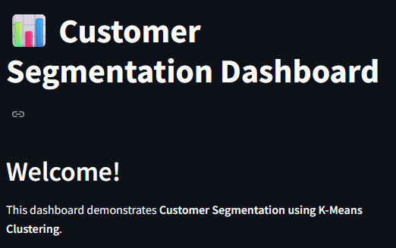
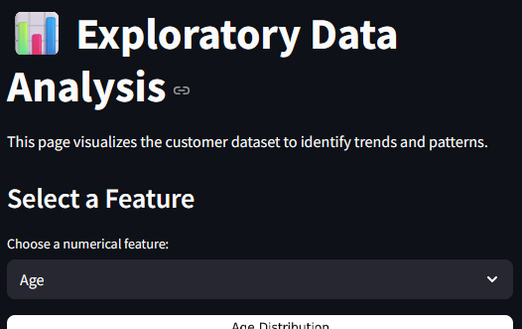
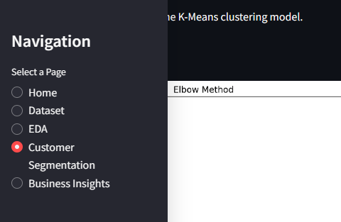
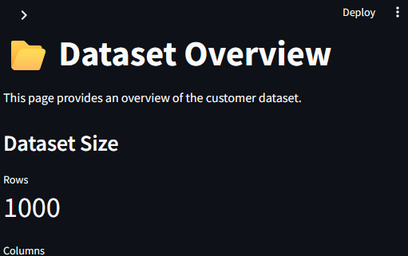
Interactive Streamlit Dashboard

Slide 12
Key Insights
Business Ideas
The K-Means algorithm successfully divided customers into four distinct segments based on annual income and spending behaviour.
Younger customers generally exhibited higher spending scores than older customers.
Customers with high annual incomes did not necessarily spend more, indicating untapped market potential.
Gender did not show a significant influence on spending behaviour.
Customer segmentation enables businesses to understand purchasing patterns and tailor marketing strategies accordingly.
For Cluster 0: Encourage higher spending through personalized promotions, premium membership programs, and targeted discounts.
For Cluster 1: Maintain customer engagement using loyalty programs, seasonal offers, and personalized product recommendations.
For Cluster 2: Develop exclusive offers, premium experiences, and individualized marketing campaigns to increase purchasing activity.
For Cluster 3: Reward loyal customers with discounts, referral programs, and products tailored to younger consumers.

Slide 13
Conclusion
This project successfully demonstrated the application of the K-Means clustering algorithm for customer segmentation by analyzing customer purchasing behaviour using annual income and spending score. Through systematic data preprocessing, exploratory data analysis, clustering, and model evaluation, four meaningful customer segments were identified. The development of an interactive Streamlit dashboard further enhanced the usability of the project by providing an intuitive platform for visualizing customer segments and deriving actionable business insights.
While the results are promising, there is considerable scope for future enhancement. The model can be improved by incorporating larger and more diverse datasets, additional customer attributes such as purchase history and demographic information, and advanced clustering techniques like DBSCAN, Hierarchical Clustering, or Gaussian Mixture Models. Integrating real-time data processing and predictive analytics could further strengthen the system, making it a more robust and scalable solution for practical business applications.

Slide 14
Thank You!

